Slide 1
SharePoint Online Service Limits and levels of administration
Speaker Name

Slide 3
Service limits and levels of administration

Slide 4
Objective
After completing this lesson, you will be familiar with:
The SharePoint Online software boundaries and requirements
SharePoint Online features
The levels of administration within the SharePoint Online environment exist
Notes:
For more information, see the Microsoft SharePoint Online Service Description TechNet article at: http://technet.microsoft.com/en-us/library/jj819267.aspx

Slide 5
Software Boundaries and Limits
Feature | Microsoft 365 Business Basic, Business Standard, Business Premium, Teams Essentials (MSA and AAD)⁷ | Microsoft 365 A3, E3, G3 & A5, E5, G5 Office 365 A3, E3, G3 & A5, E5, G5 Office 365 A1, E1, G1 SharePoint Plan 1 or 2 | Microsoft 365 F1 or F3, Office 365 F3
Total storage per organization^{1, 2, 5} | 1 TB plus 10 GB per license purchased³ | 1 TB plus 10 GB per license purchased³ | 1 TB³
Max storage per site (site collection)⁴ | 25 TB | 25 TB | 25 TB
Sites (site collections) per organization | 2 million⁵ | 2 million⁵ | 2 million
Number of users | Up to 300 | 1- 500,000⁶ | 1- 500,000⁶
https://learn.microsoft.com/en-us/office365/servicedescriptions/sharepoint-online-service-description/sharepoint-online-limits
Notes:
Limits for Site Elements in SharePoint Online:
There are also limits for the site elements of a SharePoint Online site. Some examples are:
List and library limits: Different types of columns have different limitations. For example, you can have up to 276 columns in a list for columns that contain a single line of text.
Page limits: You can add up to 25 Web Parts to a single Wiki or webpage.
Security limits: Different security features have different limits. For example, a single user can belong to no more than 5,000 security groups.
Important: It is a good idea to monitor the Recycle Bin and empty it regularly. Content in the Recycle Bin is counted against the storage quota for a tenant. For example, if the Recycle Bin on a site contains 25 GB of content, then that 25 GB is subtracted from the available storage.
The external user limit is documented here:
https://support.office.com/en-us/article/SharePoint-Online-and-OneDrive-for-Business-software-boundaries-and-limits-8F34FF47-B749-408B-ABC0-B605E1F6D498?ui=en-US&rs=en-US&ad=US
10,000 users = 1TB +(10,000 * 10GB MB) = 101TB
OneDrive for Business limits
OneDrive for Business Plan 1 provides 1 TB of storage space per user.
The following qualifying plans provide unlimited OneDrive storage per user for subscriptions with at least five users. Microsoft will provide an initial 5 TB of storage space per user. Customers who want additional OneDrive storage can request it as needed by contacting Microsoft Support. Subscriptions with less than five users receive 1 TB of storage per user.
OneDrive for Business Plan 2
SharePoint Online Plan 2
Microsoft 365 Enterprise E3
Microsoft 365 Enterprise E5
Microsoft 365 Education
Microsoft 365 Education E5
Microsoft 365 US Government E3
Microsoft 365 Government G5
Microsoft 365 Enterprise Firstline provides 2 GB of storage space per user. You cannot allocate more storage to a specific OneDrive user. However, you can lower the amount of storage that a user sees. If an Microsoft 365 Enterprise Firstline user needs more storage, then you'll need to upgrade to Microsoft 365 Enterprise E1.
Users will initially be provisioned 1 TB of personal cloud storage per user in OneDrive for Business. You may increase the default OneDrive for Business storage space to up to 5 TB per user with the help of your Microsoft 365 administrator.
Note: You must assign at least one license to a user before you can increase the default OneDrive storage space.
Whenever you need cloud storage beyond the initial 5 TB, open a case with Microsoft technical support to request it. Additional cloud storage will be granted as follows:
When a user has filled their 5 TB of OneDrive for Business storage to at least 90% capacity, Microsoft will increase your default storage space in OneDrive for Business to up to 25 TB per user (admins may set a lower per user limit if they wish to).
For any user that reaches at least 90% capacity of their 25 TB of OneDrive for Business storage, additional cloud storage will be provided as 25 TB SharePoint team sites to individual users. This additional storage is provided to the tenant by way of credit

Slide 6
Software Boundaries and Limits (continued)
Item | All Microsoft 365 Plans
Subsites | 2000
Microsoft 365 groups storage | Each individual Microsoft 365 group's file storage has the same storage and upload limits as a SharePoint Online site collection. Microsoft 365 group's file storage counts against a tenant's overall SharePoint Online storage
List file attachment size limit | 250 MB
Storage note | Empty the Recycle Bin regularly because content in there is counted against the storage quota for your tenant
Notes:
Limits for Site Elements in SharePoint Online:
There are also limits for the site elements of a SharePoint Online site. Some examples are:
List and Library limits: Different types of columns have different limitations. For example, you can have up to 276 columns in a list for columns that contain a single line of text.
Page limits: You can add up to 25 Web Parts to a single Wiki or Web page.
Security limits: Different security features have different limits. For example, a single user can belong to no more than 5,000 security groups.
Important: It is a good idea to monitor the Recycle Bin and empty it regularly. Content in the Recycle Bin is counted against the storage quota for a tenant. For example, if the Recycle Bin on a site contains 25 GB of content, then that 25 GB is subtracted from the available storage.

Slide 7
SharePoint storage allocation
1 TB per organization plus 10 GB per license purchased
If 10,000 purchased licenses
1TB +(10,000 x10GB) = 101TB of total site collection storage
This is the total storage available across all site collections within the tenant (except OneDrive for Business sites which is not pooled at the tenant level)
Site collections for Microsoft 365 Groups do consume storage from this SPO tenant storage allocation
OneDrive for Business sites (aka Personal sites) do not count against SharePoint tenant level storage
Notes:
NOTE: Recycle bin content counts against your SharePoint Online Storage.
For more information see https://docs.microsoft.com/en-us/office365/servicedescriptions/sharepoint-online-service-description/sharepoint-online-limits

Slide 8
Software Computer Requirements
Browser and Office
Microsoft 365 is designed to work with the latest browsers and versions of Office. If you use older browsers and versions of Office that are not in mainstream support:
Microsoft won’t deliberately prevent you from connecting to the service, but the quality of your Microsoft 365 experience may diminish over time.
Microsoft won’t provide software updates to resolve non-security related problems.
Operating system
Windows OS: Windows 11, Windows 10, Windows 8.1, Windows Server 2019, Windows Server 2016
macOS: One of the three most recent versions of macOS. When a new major version of macOS is released, the macOS and the previous two versions.
Linux: Microsoft 365 for the web works in the new Microsoft Edge, Firefox or Chrome on Linux, but some features may not be available.
For the best experience, use the most current build of any operating system specified above.
Notes:
For more information about software requirements, see: http://office.microsoft.com/en-us/office365-suite-help/software-requirements-for-office-365-enterprise-and-office-365-midsize-business-HA102817357.aspx?redir=0
Office is supported on the two most recent versions of iOS. When a new version of iOS is released, Office’s Operating System requirement becomes the then-current two most recent versions: the new version of iOS and the previous version.

Slide 9
Administrative Roles

Slide 10
Microsoft 365 Administrative Roles
The following admin roles are available within Microsoft 365:
Microsoft 365 admin role | Role in Exchange Online | Role in SharePoint Online | Role in Skype for Business | Role in Teams
Global admin | Microsoft Exchange Online admin Company admin | SharePoint Online admin | Skype for Business admin | N/A
Global Reader | Read Only | Read Only | Read Only | Read Only
Helpdesk admin | N/A | N/A | N/A | N/A
Service Support admin | N/A | N/A | N/A | N/A
User admin | N/A | N/A | N/A | N/A
Exchange admin | Exchange Online admin | N/A | N/A | N/A
SharePoint admin | N/A | SharePoint Online admin | N/A | N/A
Teams service admin | N/A | N/A | N/A | Teams Collaboration Admin
Depending on the size of your organization, you may want to designate several admins who serve different functions
Notes:
Exchange Admin: Assign the Exchange admin role to users who need to view and manage your user's email mailboxes, Microsoft 365 groups, and Exchange Online. Exchange admins can also: - Recover deleted items in a user's mailbox - Set up "Send As" and "Send on behalf" delegates
Global admin: Assign the Global admin role to users who need global access to most management features and data across Microsoft online services. Giving too many users global access is a security risk and we recommend that you have between 2 and 4 Global admins. Only global admins can: - Reset passwords for all users - Add and manage domains Note: The person who signed up for Microsoft online services automatically becomes a Global admin.
Global reader: Assign the global reader role to users who need to view admin features and settings in admin centers that the global admin can view. The global reader admin can't edit any settings.
Groups admin: Assign the groups admin role to users who need to manage all groups settings across admin centers, including the Microsoft 365 Admin Center and Azure Active Directory portal. Groups admins can: - Create, edit, delete, and restore Microsoft 365 Groups - Create and update group creation, expiration, and naming policies - Create, edit, delete, and restore Azure Active Directory security groups
Helpdesk admin: Assign the Helpdesk admin role to users who need to do the following: - Reset passwords - Force users to sign out - Manage service requests - Monitor service health Note: The Helpdesk admin can only help non-admin users and users assigned these roles: Directory reader, Guest inviter, Helpdesk admin, Message center reader, and Reports reader.
Office Apps admin : Assign the Office Apps admin role to users who need to do the following: - Use the Office cloud policy service to create and manage cloud-based policies for Office - Create and manage service requests - Manage the What's New content that users see in their Office apps - Monitor service healthService adminAssign the Service admin role as an additional role to admins or users whose role doesn't include the following, but still need to do the following: - Open and manage service requests - View and share message center posts
SharePoint admin: Assign the SharePoint admin role to users who need to access and manage the SharePoint Online admin center. SharePoint admins can also: - Create and delete sites - Manage site collections and global SharePoint settings
Teams service admin: Assign the Teams service admin role to users who need to access and manage the Teams admin center. Teams service admins can also: - Manage meetings - Manage conference bridges - Manage all org-wide settings, including federation, teams upgrade, and teams client settings
User admin: Assign the User admin role to users who need to do the following for all users: - Add users and groups - Assign licenses - Manage most users properties - Create and manage user views - Update password expiration policies - Manage service requests - Monitor service health The user admin can also do the following actions for users who aren't admins and for users assigned the following roles:
Directory reader, Guest inviter, Helpdesk admin, Message center reader, Reports reader: - Manage usernames - Delete and restore users - Reset passwords - Force users to sign out - Update (FIDO) device keysto manage Teams.

Slide 11
Assigning an Admin Role
Go
Go to the Microsoft 365 admin center
Select
Select Users from the quick menu on the left
Click
Click Active Users from the drop-down list
Click
Click the display name you want to assign the role to
Scroll down
Scroll down to “Roles” and click edit on the right side
Or with Microsoft Azure Active Directory PowerShell Module:
add-msolrolemember -rolename “SharePoint Service Administrator” -rolememberemailaddress "user2@678contoso.onmicrosoft.com"

Slide 12
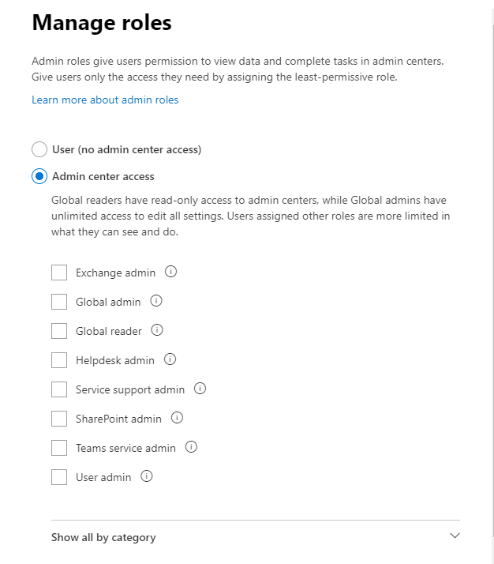
Microsoft 365 Administrative Roles (Continued)
Admin roles in Microsoft 365 enable you to delegate admins for each individual Microsoft 365 service.
They do not require user to be a global admin to administer SharePoint Online, Exchange Online or other apps.
Notes:
https://support.office.com/en-us/article/About-Office-365-admin-roles-da585eea-f576-4f55-a1e0-87090b6aaa9d

Slide 13
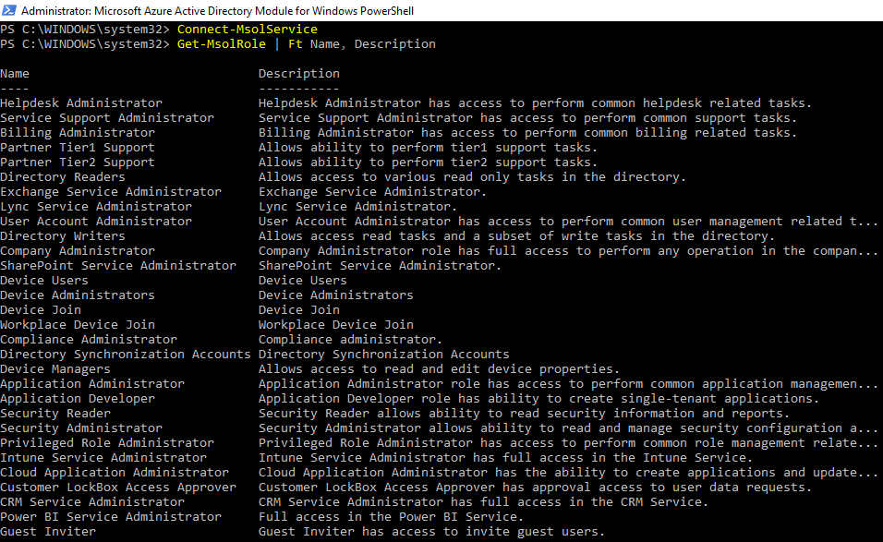
Get-MsolRole
Notes:
We can compare to the GUI list of roles – A lot of roles that you don’t see in the GUI will also appear
NOTE: Get-MSOLRole
For a complete list of all M365 admin roles see About admin roles
https://docs.microsoft.com/en-US/microsoft-365/admin/add-users/about-admin-roles?view=o365-worldwide

Slide 14
Microsoft 365 Administrative Roles (continued)
SharePoint Service administrator: Has administrative access to SharePoint Online through the SharePoint Online admin center, and PowerShell, and can perform SharePoint Online tenant level tasks.
Exchange Service administrator: Has administrative access to Exchange Online through the Exchange admin center and can perform almost any task in Exchange Online.
Teams service admin: Can manage all aspects of Microsoft Teams except license assignment.
Teams communications admin: Can manage calling and meeting features of Microsoft Teams, including phone number assignments and meeting policies. They can also use call analytics tools to troubleshoot issues.
Notes:
For a detailed list of admin permissions by role, refer to Assigning admin roles in Microsoft 365: https://support.office.com/en-US/article/Assigning-admin-roles-in-Office-365-EAC4D046-1AFD-4F1A-85FC-8219C79E1504

Slide 15
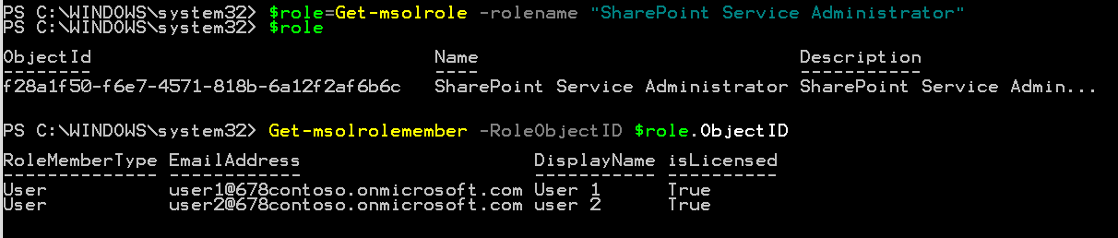
Viewing Role Membership
Notes:
The following commands return all the members of the specified role "Company Administrator“:
$role = Get-MsolRole -RoleName "Company Administrator"
Get-MsolRoleMember -RoleObjectId $role.ObjectId

Slide 16
SharePoint Online Levels of Administration
There are five administrative roles in SharePoint Online service administration:
Farm Administrator:
SharePoint Administrator:
Site Collection Administrator:
Site Administrator:
Global Administrator:
Microsoft engineers working in Microsoft datacenters
A Microsoft 365 tenant-level administrator who can also administer the SharePoint Online environment using the SharePoint admin center
Administers the SharePoint Online service within the Microsoft 365 tenant
Manages site collection level settings within the site collection
Manages sites and/or subsites within a site collection
Note: Remember Site Collection Administrators do not have access to the SharePoint Online Admin Center or any of the features available at the tenant level.
Notes:
There are four administrative roles in the SharePoint Online service administration:
Farm Administrator: Performs IT tasks, thus providing IT teams with more time for other administrative tasks within the organization. Farm administrators can:
Manage farm-level settings and hardware.
Control database configurations.
Install all new approved farm-level features and solutions.
Apply all security updates.
Perform farm and server maintenance.
Global Administrator: The administrator for the Microsoft 365 Portal who can manage all services within the tenant. Some of these tasks include:
Creating and managing site collections
Designating site collection administrators
Microsoft Exchange Online
Skype for Business Online
Tenant-Level settings
Service licenses
Users and groups
Domains
Subscribed services
SharePoint Administrator: Manages and administers the SharePoint Online service within the Microsoft 365 tenant
Site Collection Administrator: Manages the Site Collections and site collection settings such as permissions, site collection features, galleries, and navigation settings.
Site Administrator: Manages sites and/or subsites within a site collection.

Slide 17
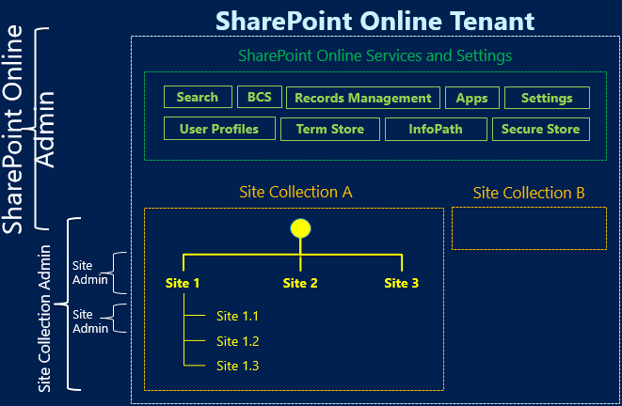
Levels of SharePoint Administration

Slide 18
SharePoint Online Administrator
Key tasks of SharePoint Admins
Configure and manage SharePoint Online tenant level settings
Configure and manage External Sharing settings for SharePoint Online and OneDrive for Business
Add and remove site collection administrators
Manage site collection and ODFB storage limits
Manage SharePoint Online user profiles
Manage shared managed metadata taxonomy
Manage search center configuration
When you assign someone the SharePoint admin role, you may also want to assign them to Service administrator role. This way they can see important information in the Microsoft 365 admin center, such as the health of the SharePoint Online service, and change and release notifications.

Slide 19
Site Collection and Site Admins
Site Collection Administrators vs. Site Administrators
Site Collection Administrators | Site Administrators
Have full control access to all sites, content, and administration settings within the site collection Have access to the site collection administration settings Are members of the site collection Administrators group Site collection administrators receive administrative messages for the site collection such as reaching quota limit | Have full control access to all site content and site administration settings within an individual site Do not have access to the site collection administration settings Are members of the owners group for a site within a site collection Can receive administrative messages for the site
Notes:
http://roadmap.office.com/en-us?legRedir=true&CorrelationId=586bd2b1-8698-4b2c-8a89-84f0af4eadc8#R-142-2012

Slide 20
Knowledge Check
How much personal storage do users currently have in Microsoft 365 for Enterprise?
Unlimited
Which Internet Explorer version is supported with Microsoft 365 and which browser versions are recommended for SharePoint Online?
Latest versions Microsoft Edge, Chrome, Safari and Firefox
Briefly explain the different levels of administration in SharePoint Online.
Global Administrator, SharePoint Administrator, Site Collection Administrator, Site Administrator
What are some of the common tasks a global admin can perform within the SharePoint admin center?
Create site collections, grant access to SC Admins, manage external user settings, assign storage, monitor delete, and restore deleted site collections

Slide 21
Summary
In this lesson, you learned about
SharePoint Online features and capabilities
SharePoint Online software boundaries and requirements?
The levels of administration within the SharePoint Online environment

